Slide 1
EMIRATES NBD Projects done June 2022 - September 2023

Slide 2
ENBD - EMIRATI VISA DEBIT CARD THANK YOU PROMO CAMPAIGN
FB,LINKEDIN, INSTAGRAM,TWITTER
INSTAGRAM STORY, SNAPCHAT, TIKTOK

Slide 3
ENBD - BLOOMINGDALE’S 150TH ANNIVERSARY

Slide 4
ENBD - BLOOMINGDALE’S 150TH ANNIVERSARY

Slide 5
ENBD - BLOOMINGDALE’S 150TH ANNIVERSARY

Slide 6
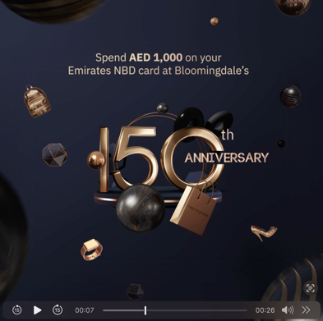
ENBD - BLOOMINGDALE’S 150TH ANNIVERSARY
SOCIAL MEDIA ITEMS (VIDEOS)

Slide 7
ENBD - BLOOMINGDALE’S 150TH ANNIVERSARY
SOCIAL MEDIA ITEMS (VIDEOS)

Slide 8
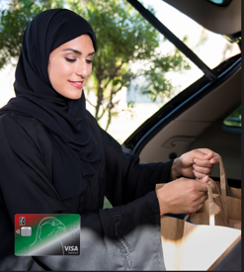
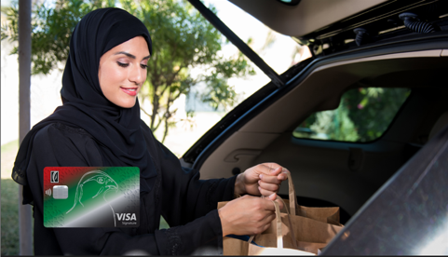
ENBD - EMIRATI DEBIT CARD - RAMADAN UNION COOP CAMPAIGN
WEB BANNERS
APP BANNER

Slide 9
ENBD - EMIRATI DEBIT CARD - RAMADAN UNION COOP CAMPAIGN

Slide 10
ENBD - EMIRATI DEBIT CARD - RAMADAN UNION COOP CAMPAIGN

Slide 11
ENBD WOMEN’S DAY CAMPAIGN

Slide 12
ENBD- REHLATY PINK MONTH EDM

Slide 13
ENBD - SUMMER TRAVEL OFFERS CAMPAIGN - PSB

Slide 14
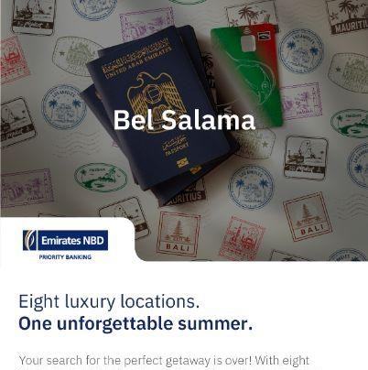
ENBD - SUMMER TRAVEL OFFERS CAMPAIGN - PRB

Slide 15
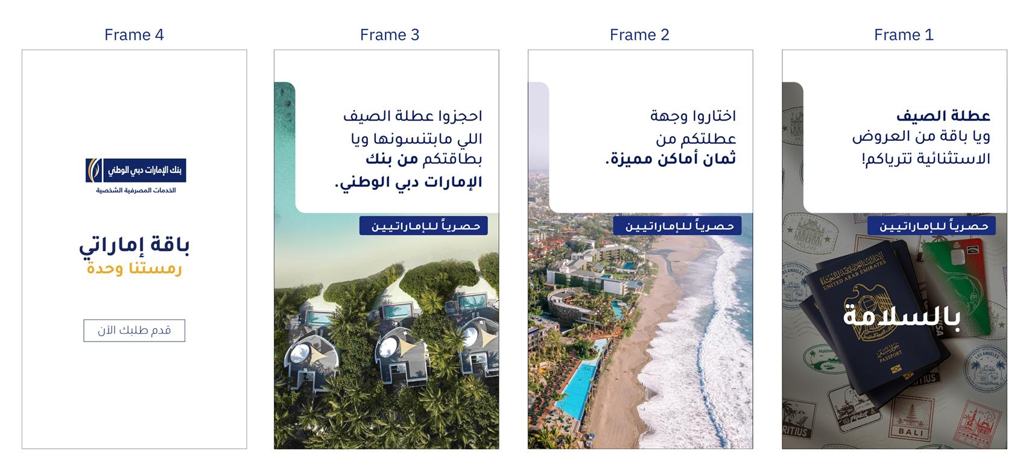
ENBD - SUMMER TRAVEL OFFERS CAMPAIGN

Slide 16
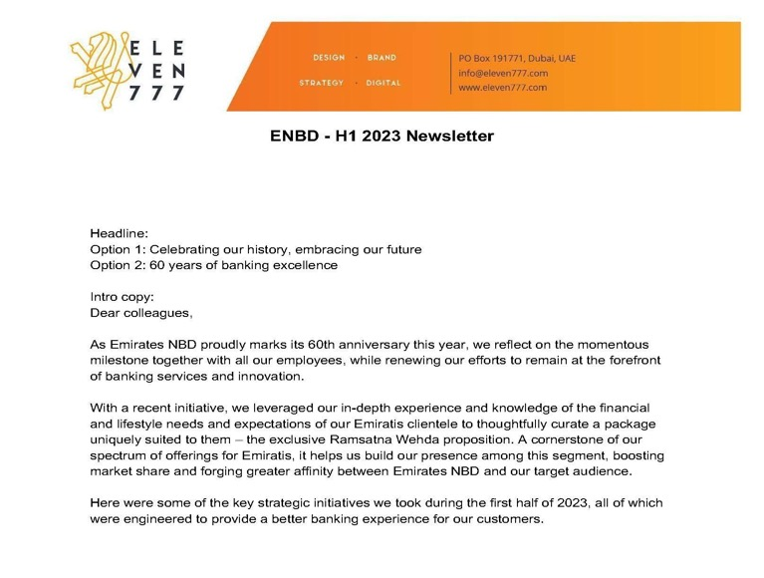
ENBD - H1 E-NEWSLETTER COPYWRITING

Slide 17
ENBD - BACK TO SCHOOL CASHBACK PROMO EDM

Slide 18
ENBD - BACK TO SCHOOL CASHBACK PROMO WEB BANNER

Slide 19
ENBD - BACK TO SCHOOL CASHBACK PROMO IG STORY

Slide 20
ENBD - BACK TO SCHOOL CASHBACK PROMO ANIMATION

Slide 21
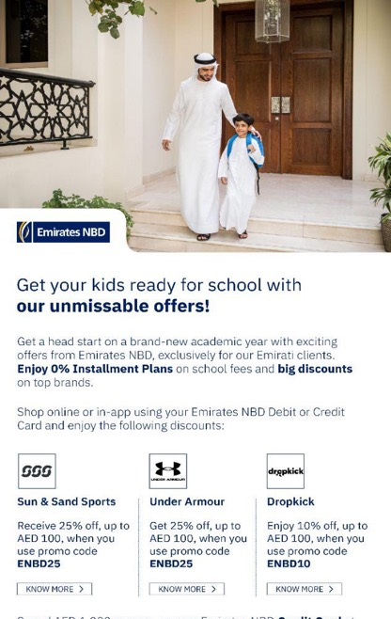
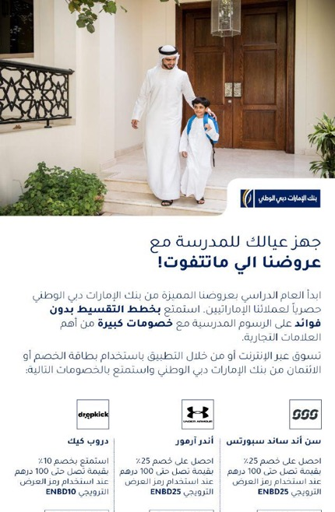
ENBD - BACK TO SCHOOL CAMPAIGN EDM

Slide 22
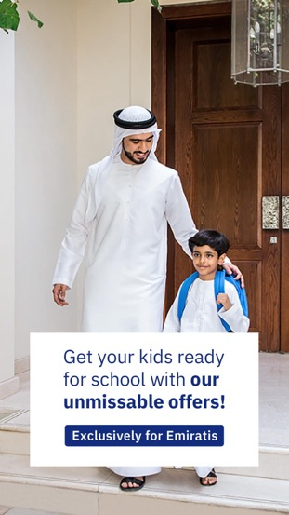
ENBD - BACK TO SCHOOL CAMPAIGN SM
LINKEDIN,TWITTER,INSTAGRAM
INSTAGRAM STORY
SNAPCHAT

Slide 23
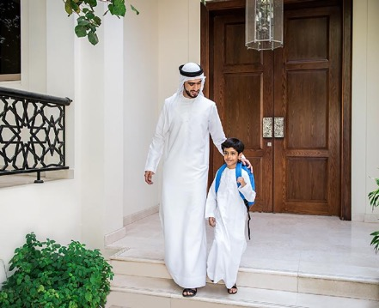
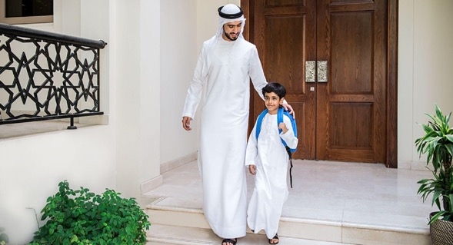
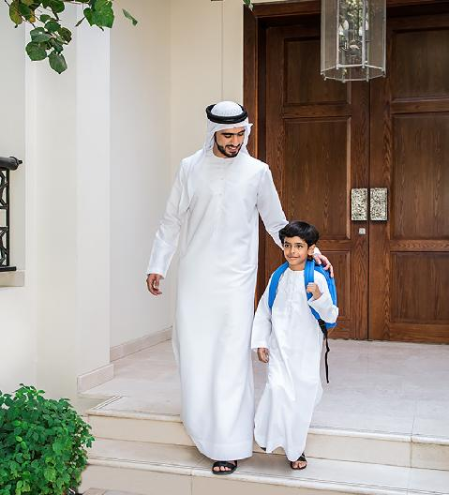
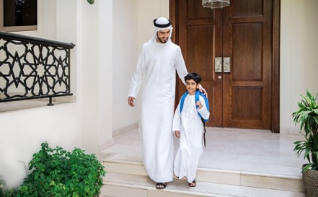
ENBD - BACK TO SCHOOL CAMPAIGN SM WEB BANNERS

Slide 24
ENBD - BACK TO SCHOOL CAMPAIGN APP BANNER

Slide 25
ENBD - EMIRATI ACQUISITION NTB - ATM SCREENS

Slide 26
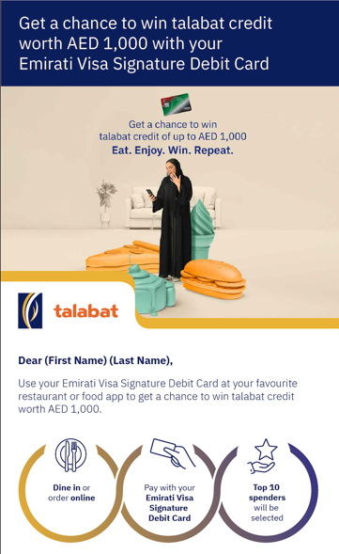
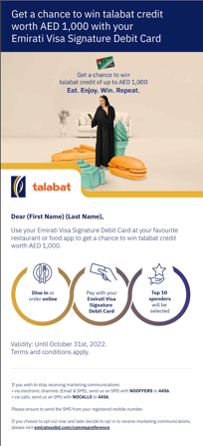
ENBD - TALABAT CAMPAIGN EDMS

Slide 27
ENBD - TALABAT CAMPAIGN EDMS
Click here to watch the video

Slide 28
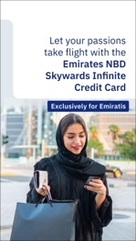
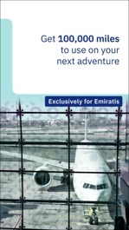
ENBD - SKYWARDS CAMPAIGN
IG story

Slide 29
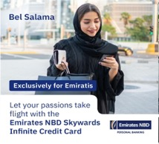
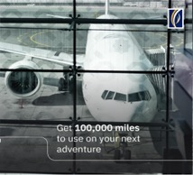
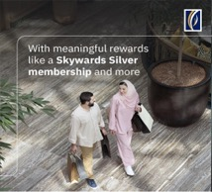
ENBD - SKYWARDS CAMPAIGN
FB/IG Carousel

Slide 30
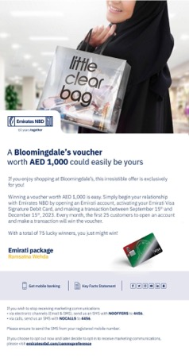
EMIRATI ACQUISITION CAMPAIGN - BLOOMINGDALES OFFER

Slide 31
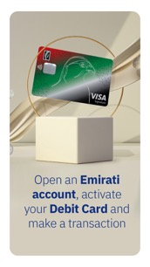
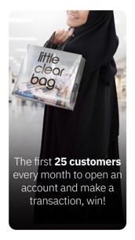
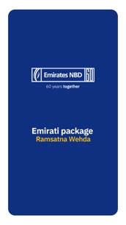
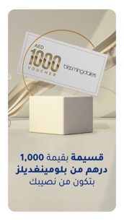
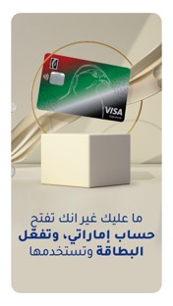
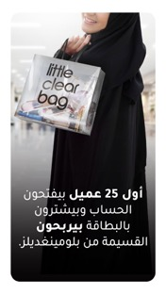
EMIRATI ACQUISITION CAMPAIGN - BLOOMINGDALES OFFER
IG story

Slide 32
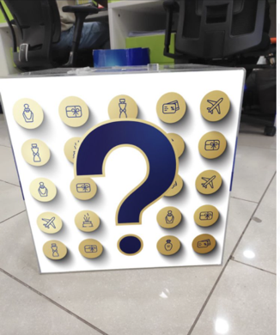
ENBD- LAM ACTIVITY - MIRDIFF ROLL UP AND BOX

Slide 33
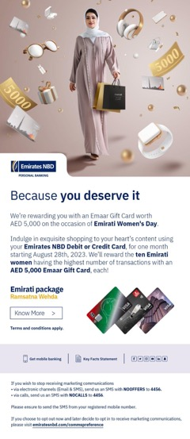
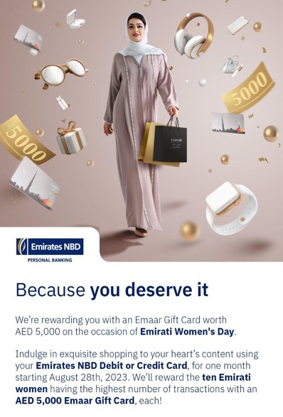
ENBD- PERSONAL BANKING EMIRATI WOMEN’S DAY CAMPAIGN

Slide 34
ENBD- PERSONAL BANKING EMIRATI WOMEN’S DAY CAMPAIGN

Slide 35
ENBD- PERSONAL BANKING EMIRATI WOMEN’S DAY CAMPAIGN

Slide 36
ENBD- CASH BACK OFFER CAMPAIGN (HAPPINESS DAY ACTIVATION)

Slide 37
ENBD- CASH BACK OFFER CAMPAIGN (HAPPINESS DAY ACTIVATION)

Slide 38
ENBD- EMIRATI SPEND CAMPAIGN (BLOOMINGDALE’S VOUCHER OFFER)

Slide 39
ENBD- EMIRATI SPEND CAMPAIGN (BLOOMINGDALE’S VOUCHER OFFER)

Slide 40
ENBD- EMIRATI SPEND CAMPAIGN (BLOOMINGDALE’S VOUCHER OFFER)

Slide 41
ENBD- INFLUENCER LEAD WEBPAGE UBE INFINITE - COPYWRITING

Slide 42
ENBD- AWARENESS OF EMIRATI PACKAGE EDMs

Slide 43
ENBD- PINK MONTH SPA OFFER EDM

Slide 44
CUSTOMER JOURNEY PSB

Slide 45
CUSTOMER JOURNEY PSB

Slide 46
CUSTOMER JOURNEY PSB

Slide 47
THANK YOU

